Slide 1
CM3035 Advanced Web Development
Lesson L15
Created by Ben Gay

Slide 2
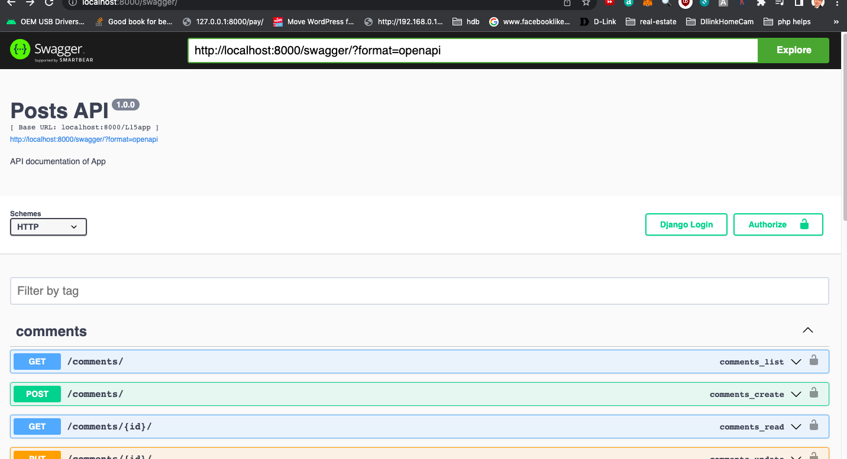
Open API
Swagger

Slide 3
Create Django project and application
L15proj
L15app

Slide 4
Module installation into Virtual Environment
Pip3 install djangorestframework
Pip3 install drf_yasg
brew install GDAL or pip3 install GDAL
https://www.lfd.uci.edu/~gohlke/pythonlibs/#gdal

Slide 5
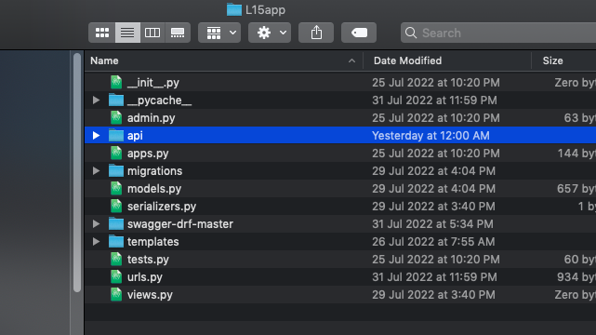
Save folder into L15app

Slide 6
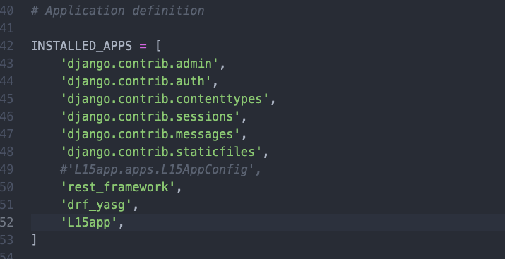
L15proj/settings.py

Slide 7
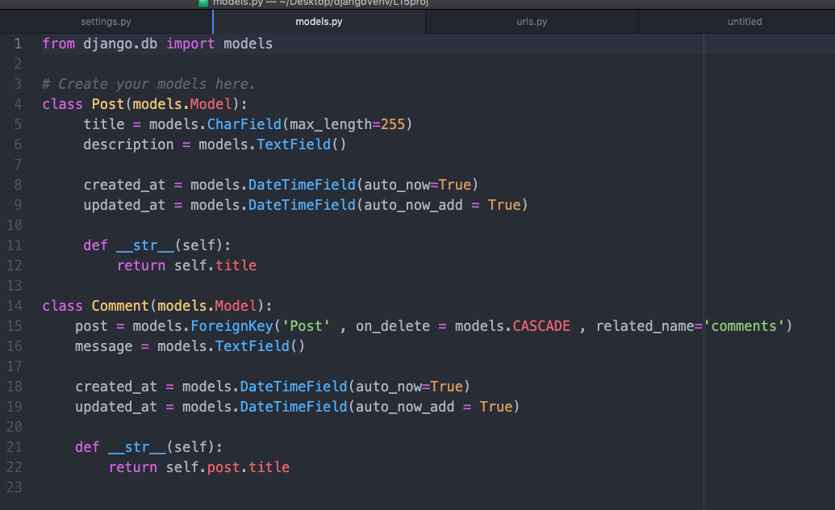
L15app/models.py

Slide 8
L15app/models.py
Python3 manage.py makemigrations
Python3 manage.py migrate

Slide 9
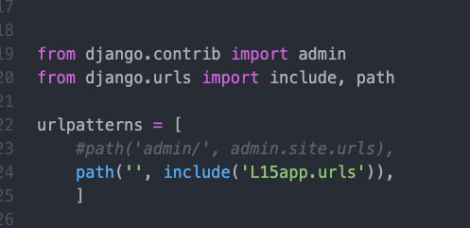
L15proj/urls.py

Slide 10
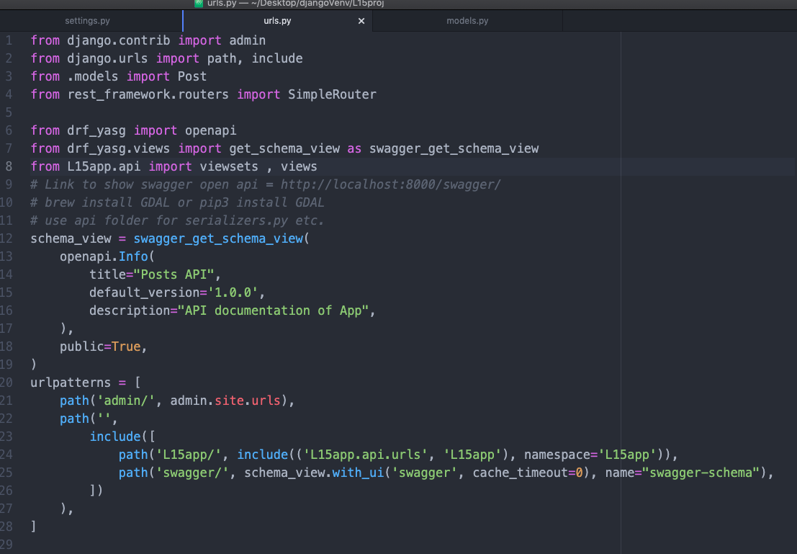
L15app/urls.py

Slide 11
Endpoint
http://localhost:8000/swagger/

Slide 12
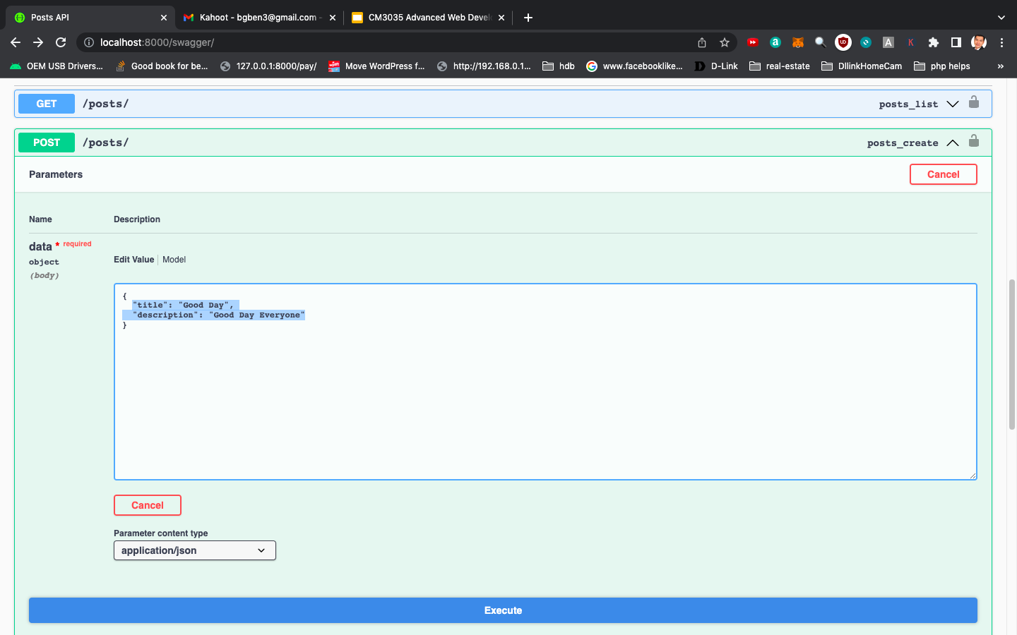
Test insert new post

Slide 13
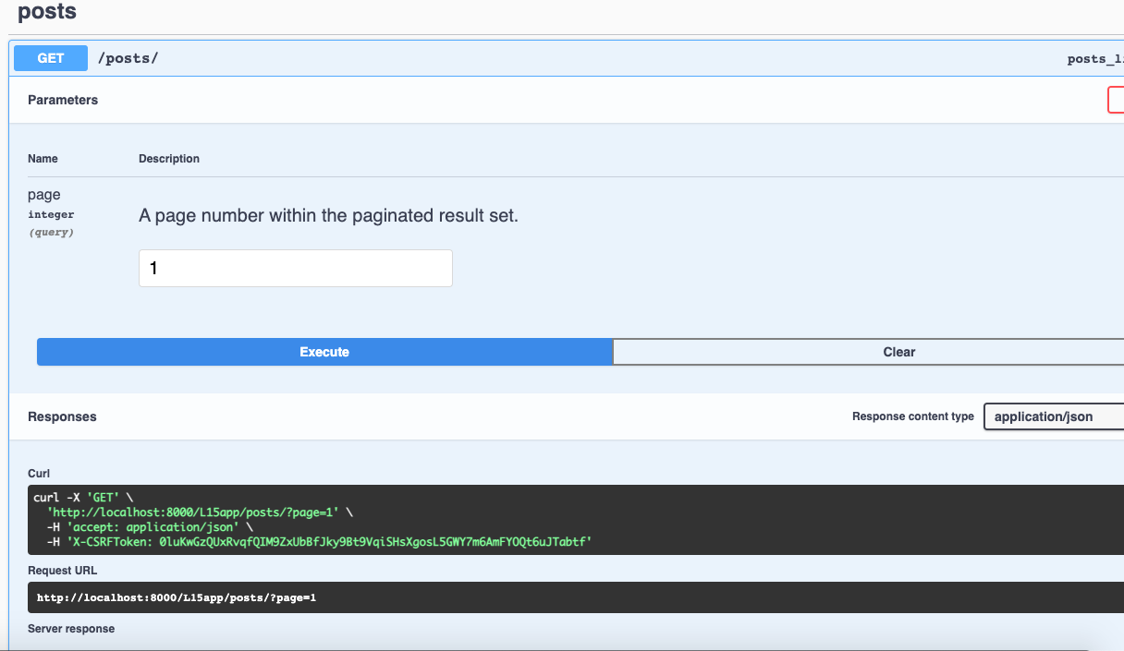
Result

Slide 14
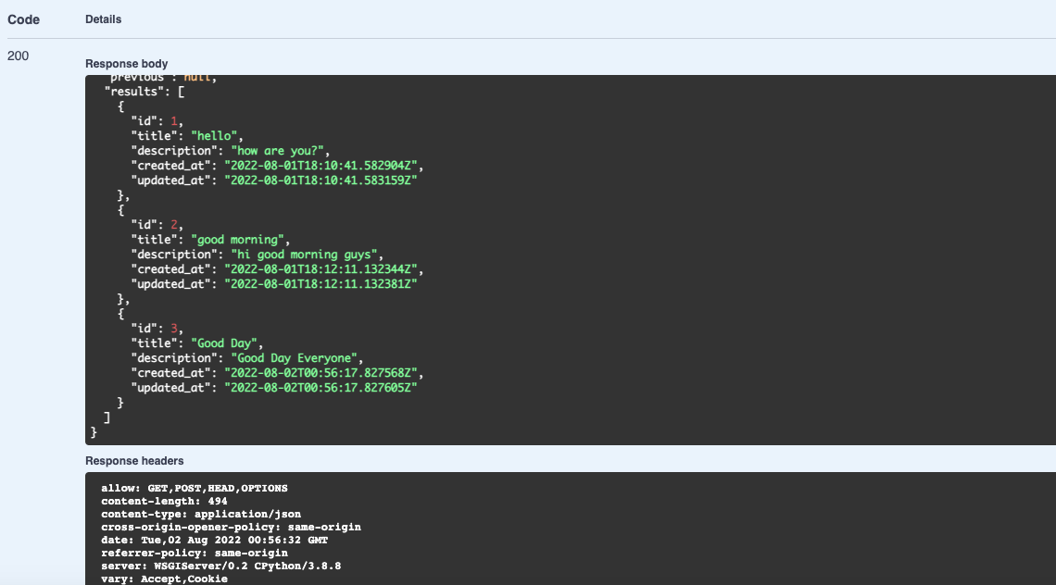
Result

Slide 15
End of Lesson 15

